Slide 1


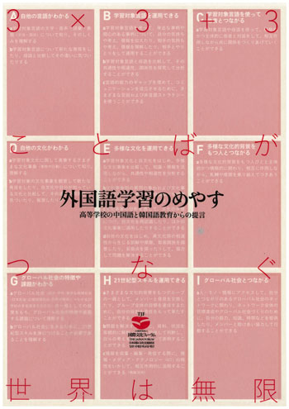
Understand Meyasu in 3 Minutes

Slide 2
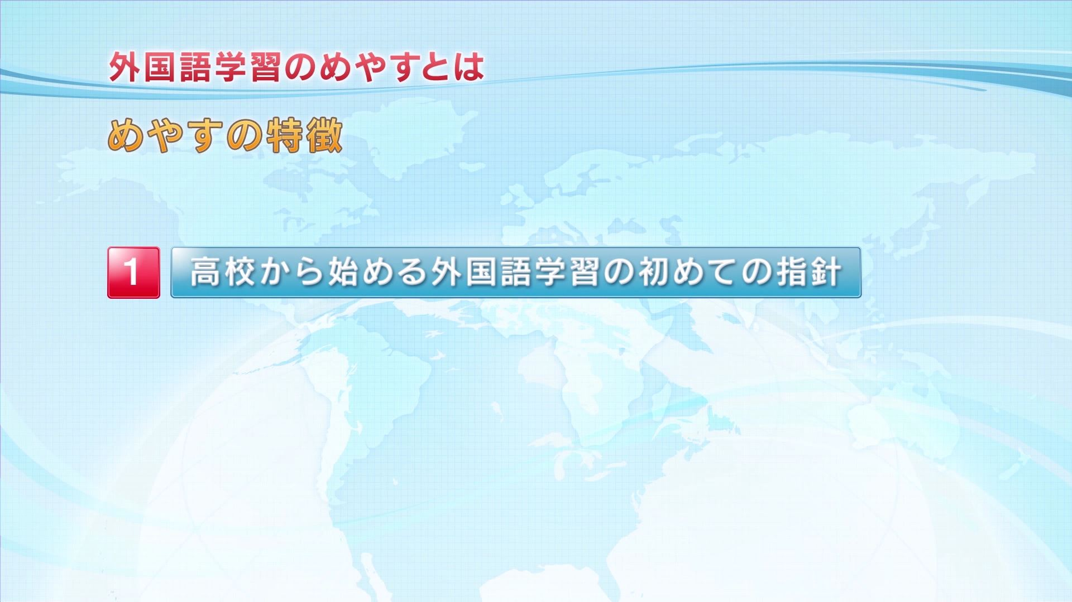
Meyasu is the first standard for foreign language learning in Japan made for the courses offered from the high school level.

Slide 3
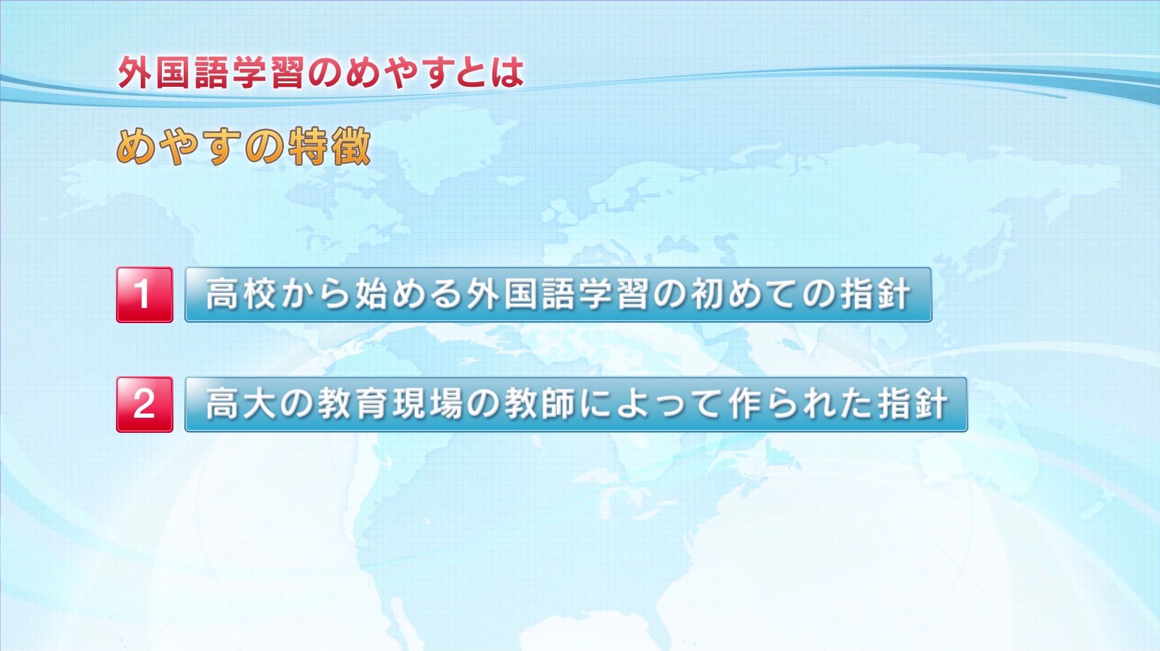
It was created by college and high school teachers of foreign languages.

Slide 4
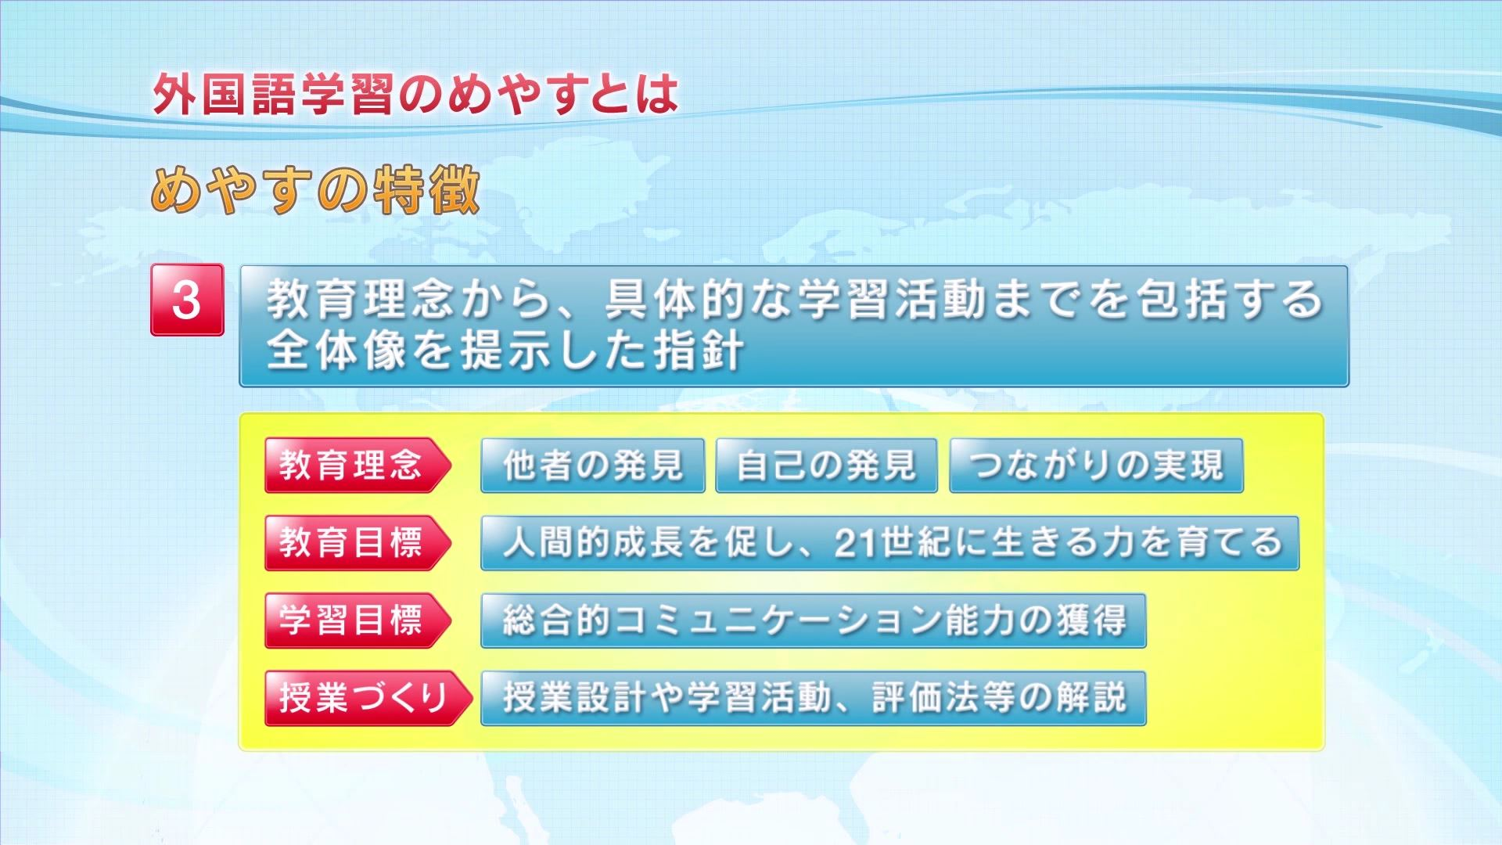
Most importantly, it contains more than educational philosophies and goals. It offers the overall picture of how to support learners showing specific learning targets to be attained, methods for curriculum designing and assessment.

Slide 5
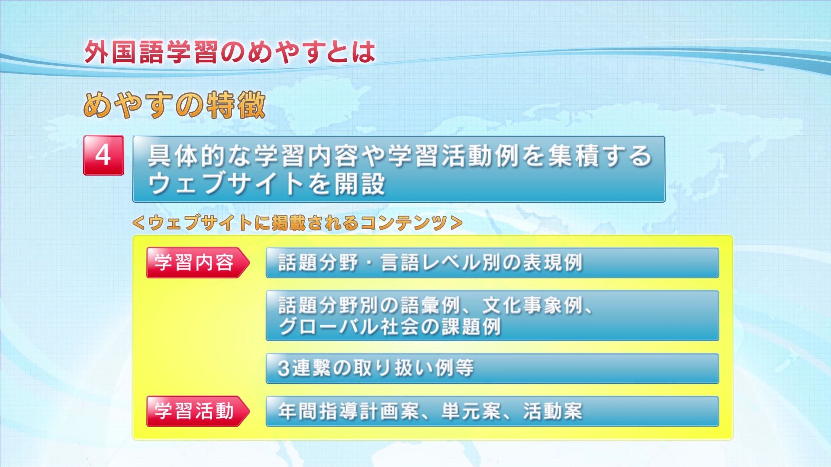
The teaching resources uploaded on the Meyasu Website are noteworthy. Various samples of study contents, classroom activities and lesson plans are freely available for the convenience of teachers in the field.

Slide 6
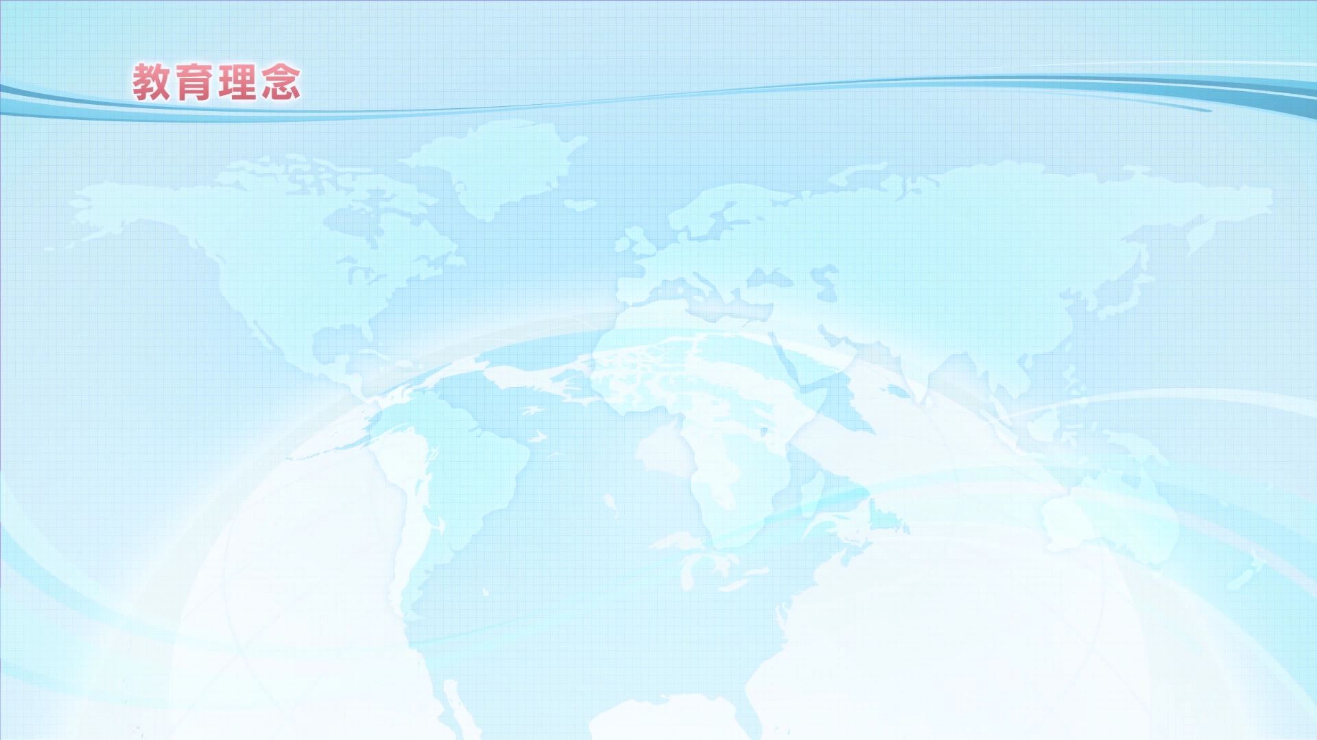
What does Meyasu aim at?

Slide 7
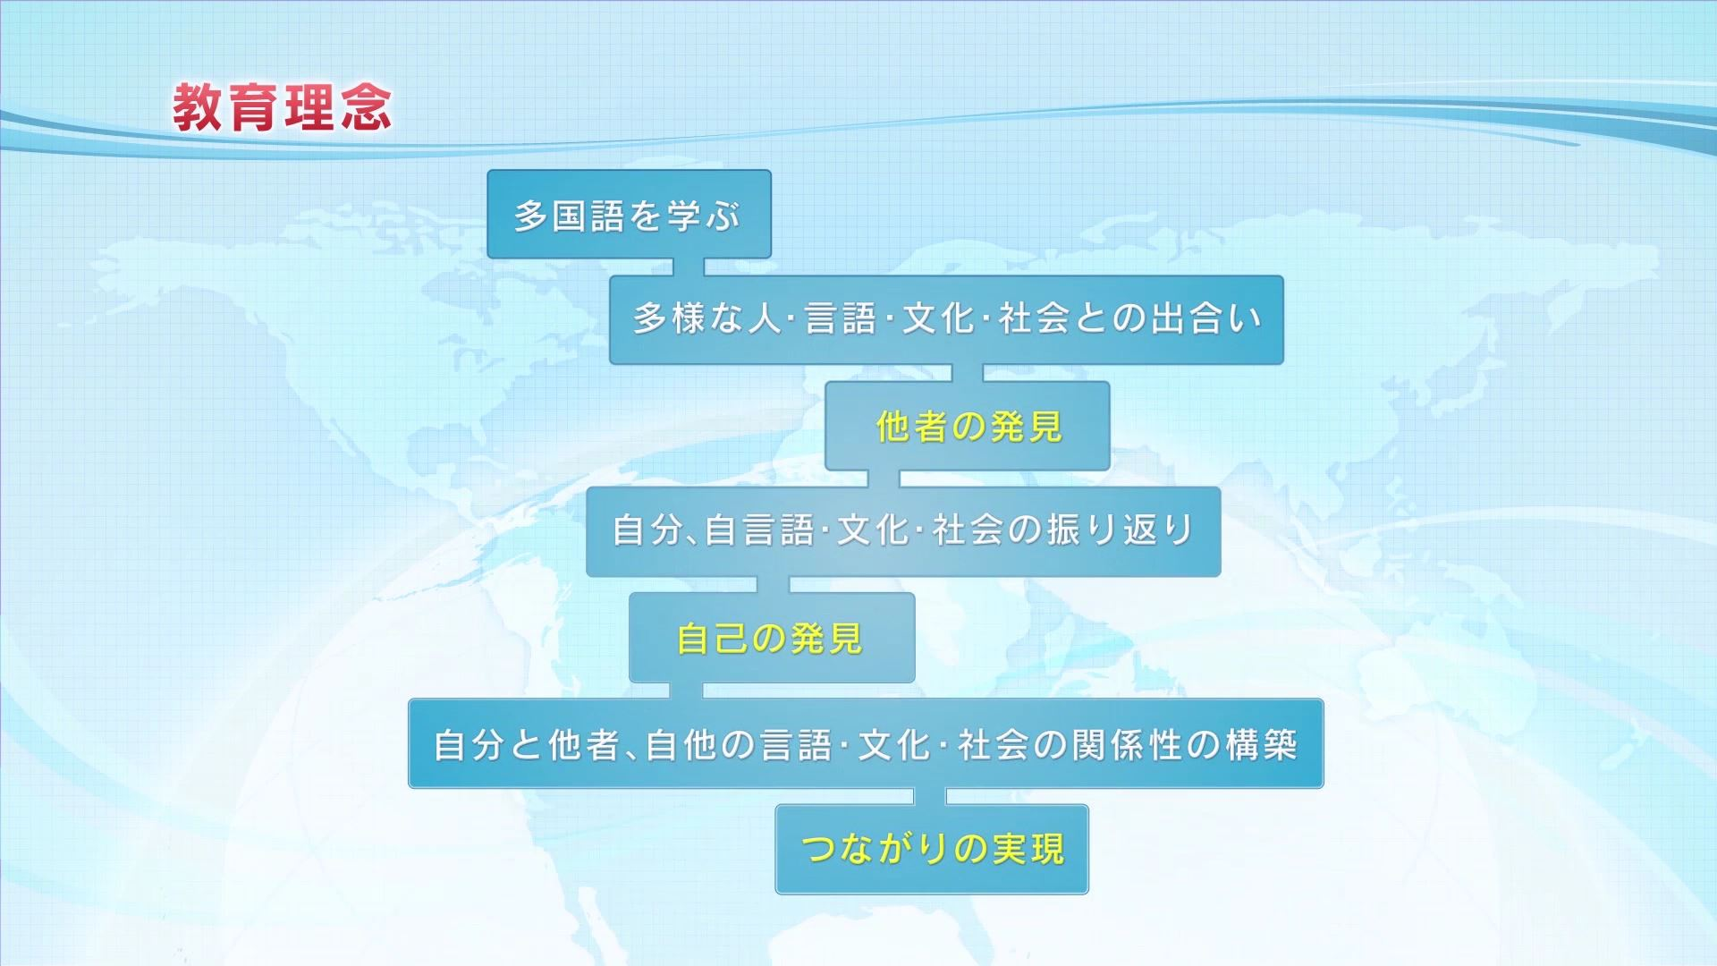
The education philosophy of Meyasu is "Discover Others, Discover Oneself", Attain Connectedness. "

Slide 8
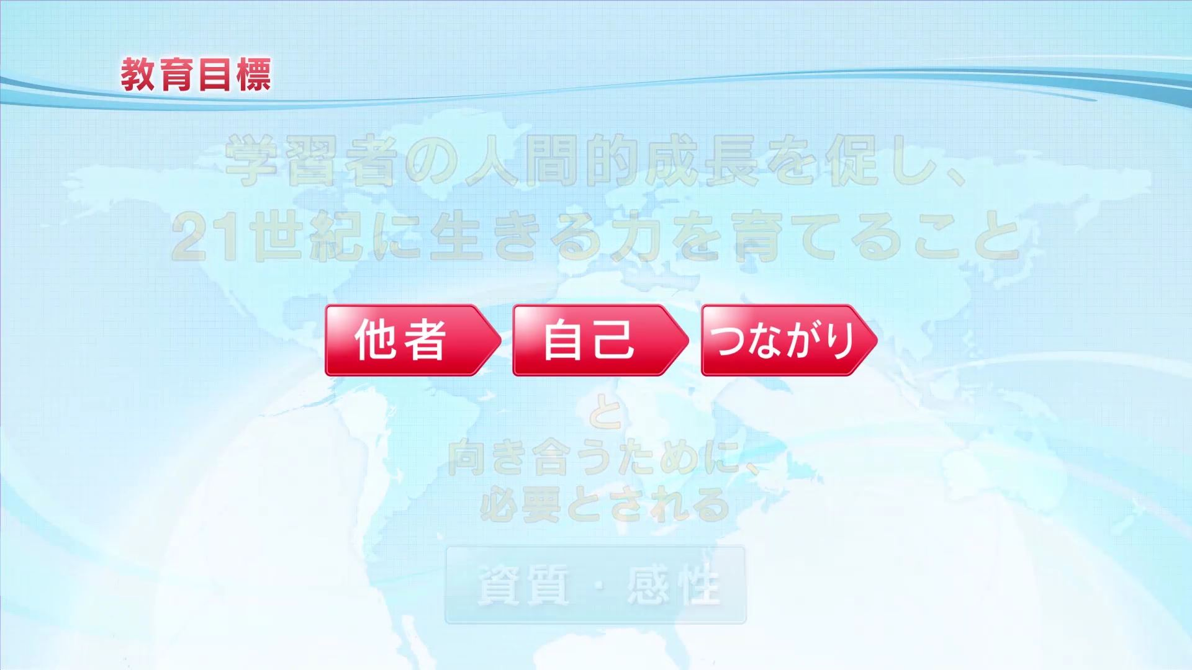

Slide 9
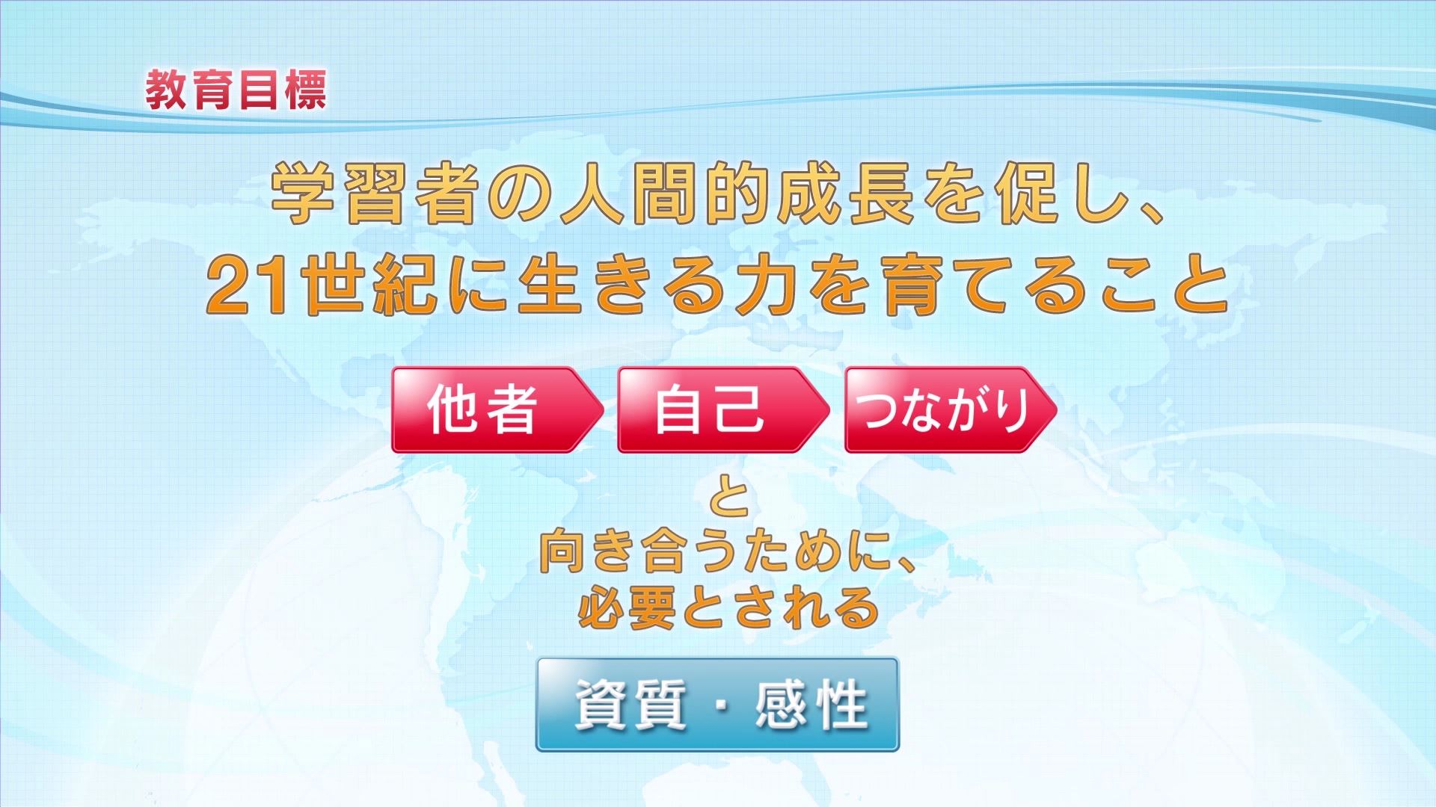
Its educational goal is to facilitate the human growth of learners and nurture their capacity to survive the 21st century through the learning of language, culture and global society.

Slide 10
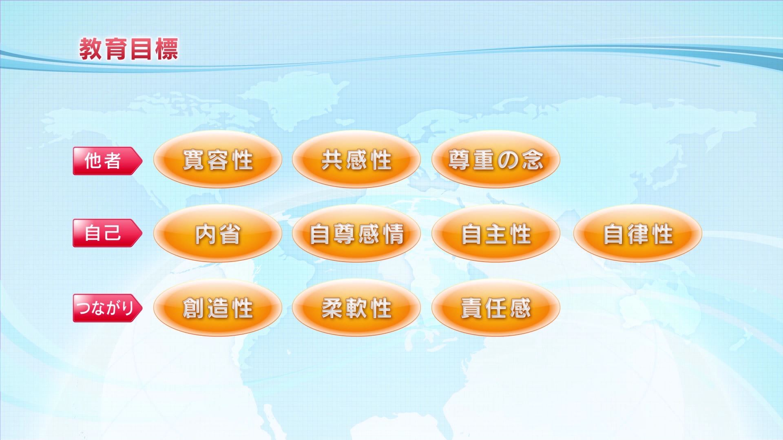
Meyasu specified 10 qualities and sensitivities learners need to achieve. All are considered important 21st century skills.

Slide 11
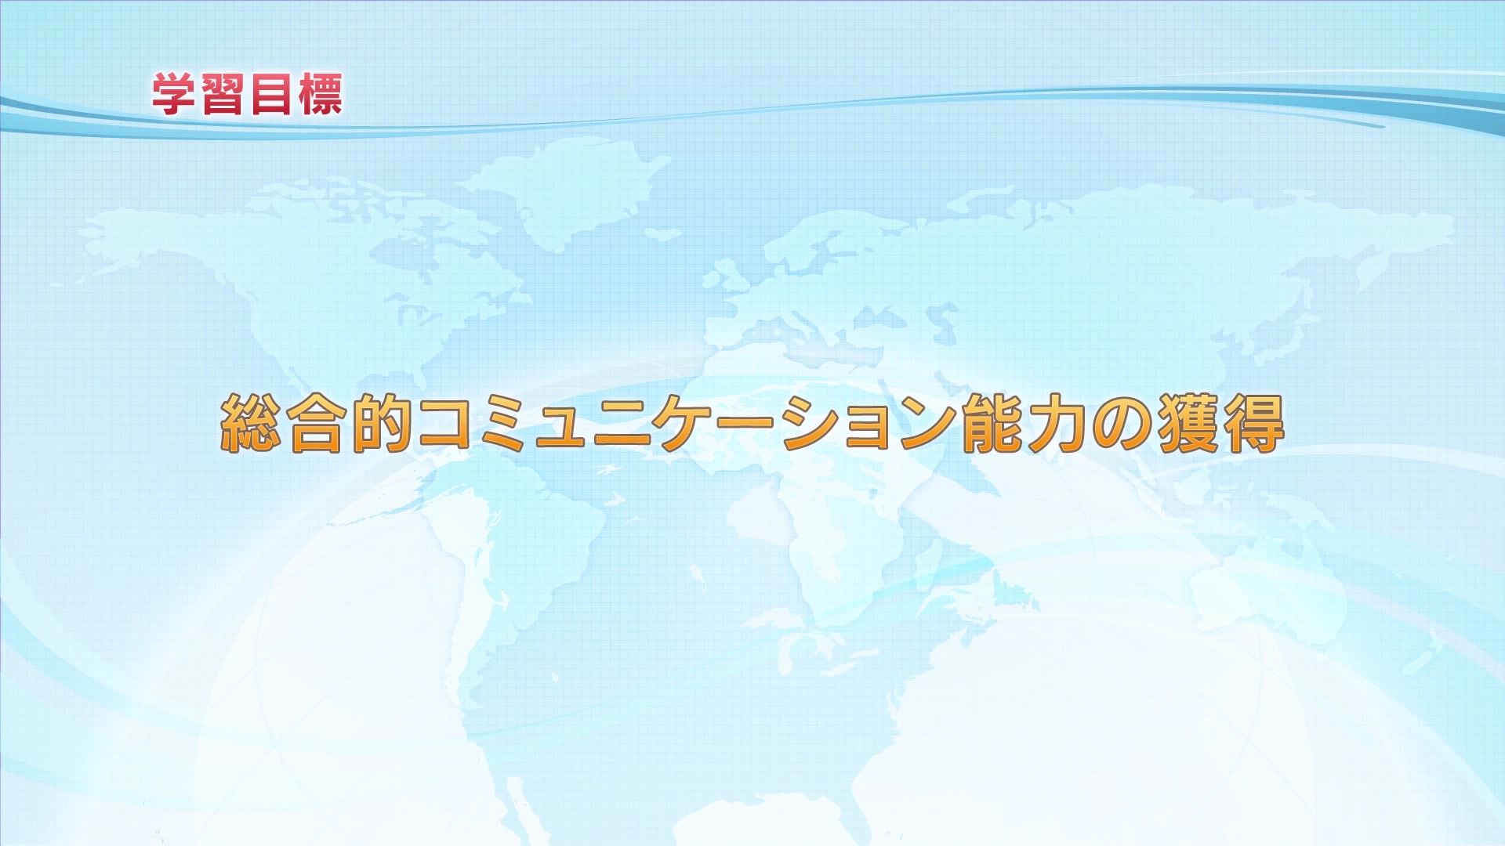
The learning target in Meyasu is to develop comprehensive communication competence.

Slide 12
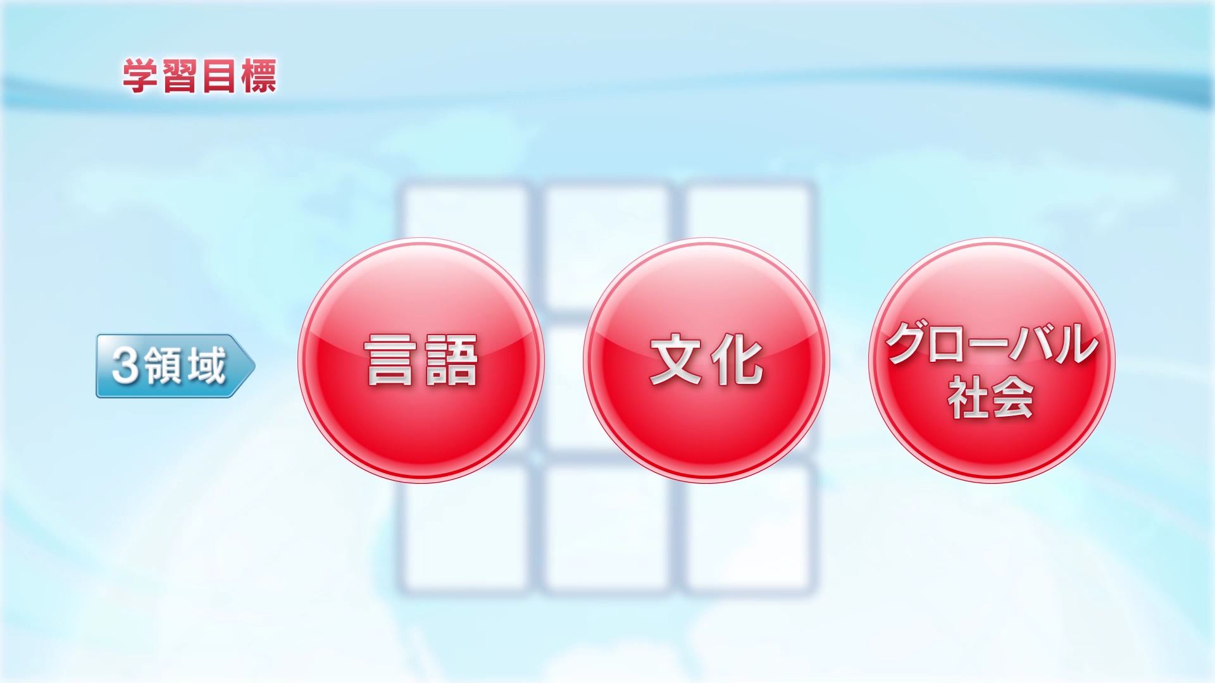
The comprehensive communication competence consists of three dimensions: language, culture and global society.

Slide 13
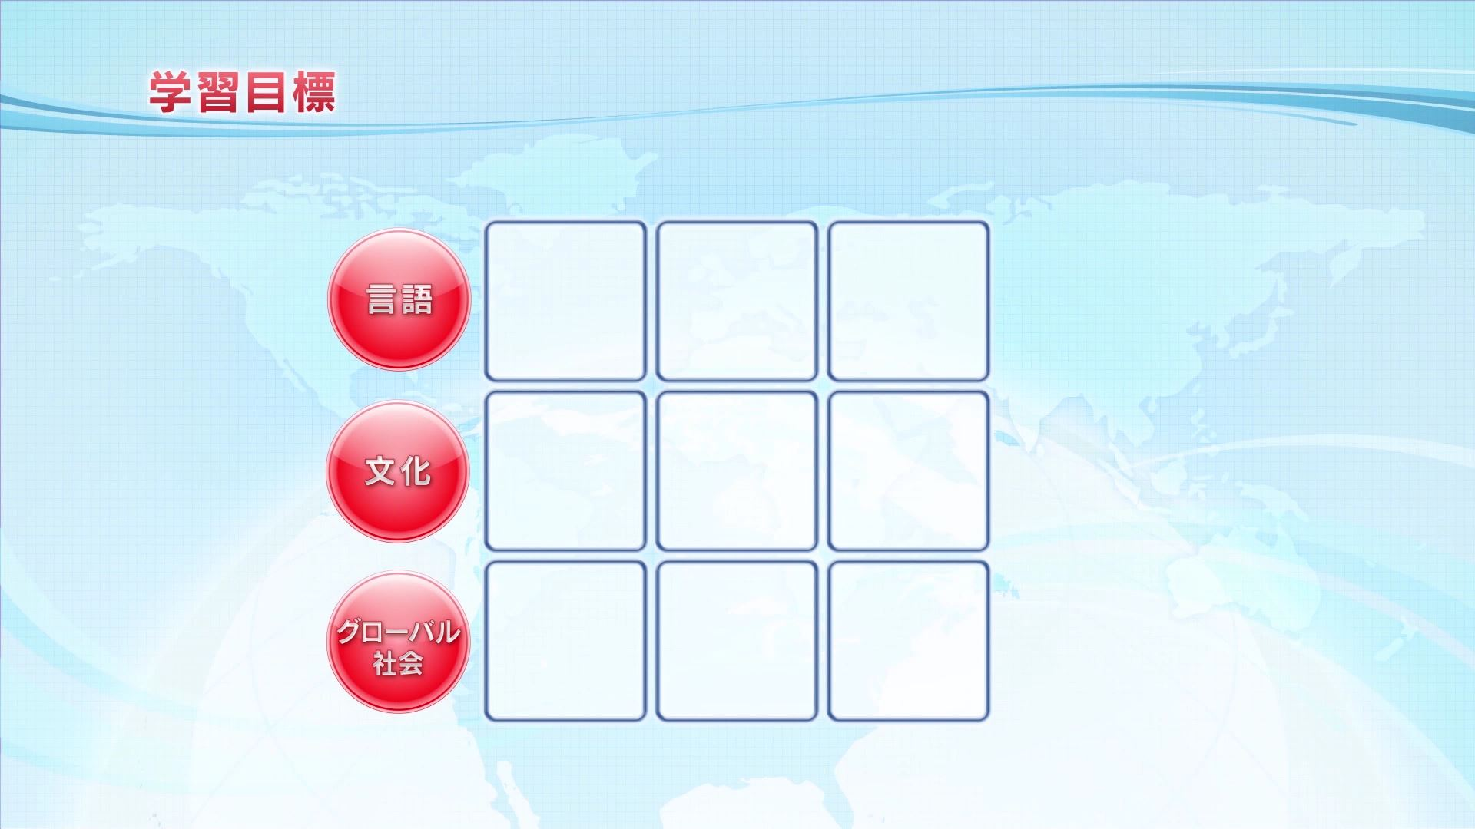

Slide 14
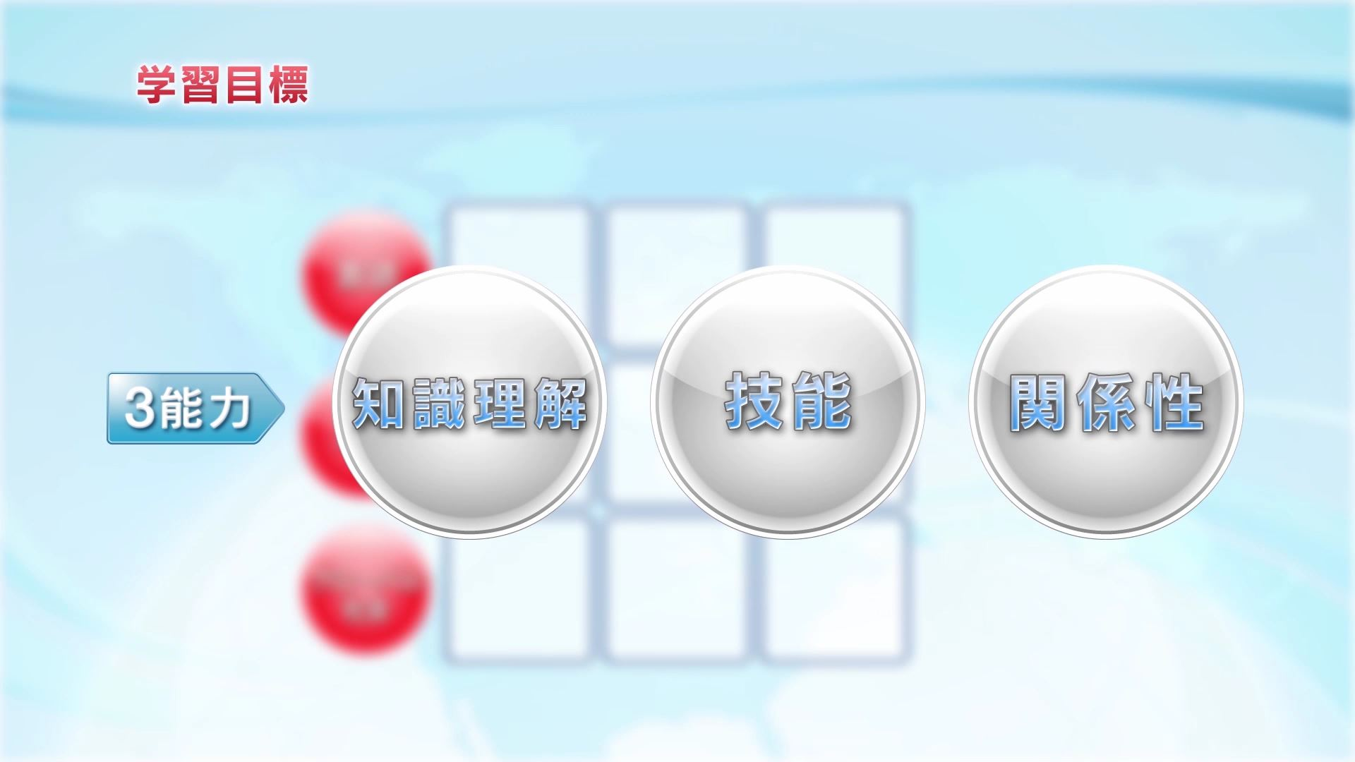
In each dimension, learners are to acquire knowledge and understanding, skills and relationship building ability.

Slide 15
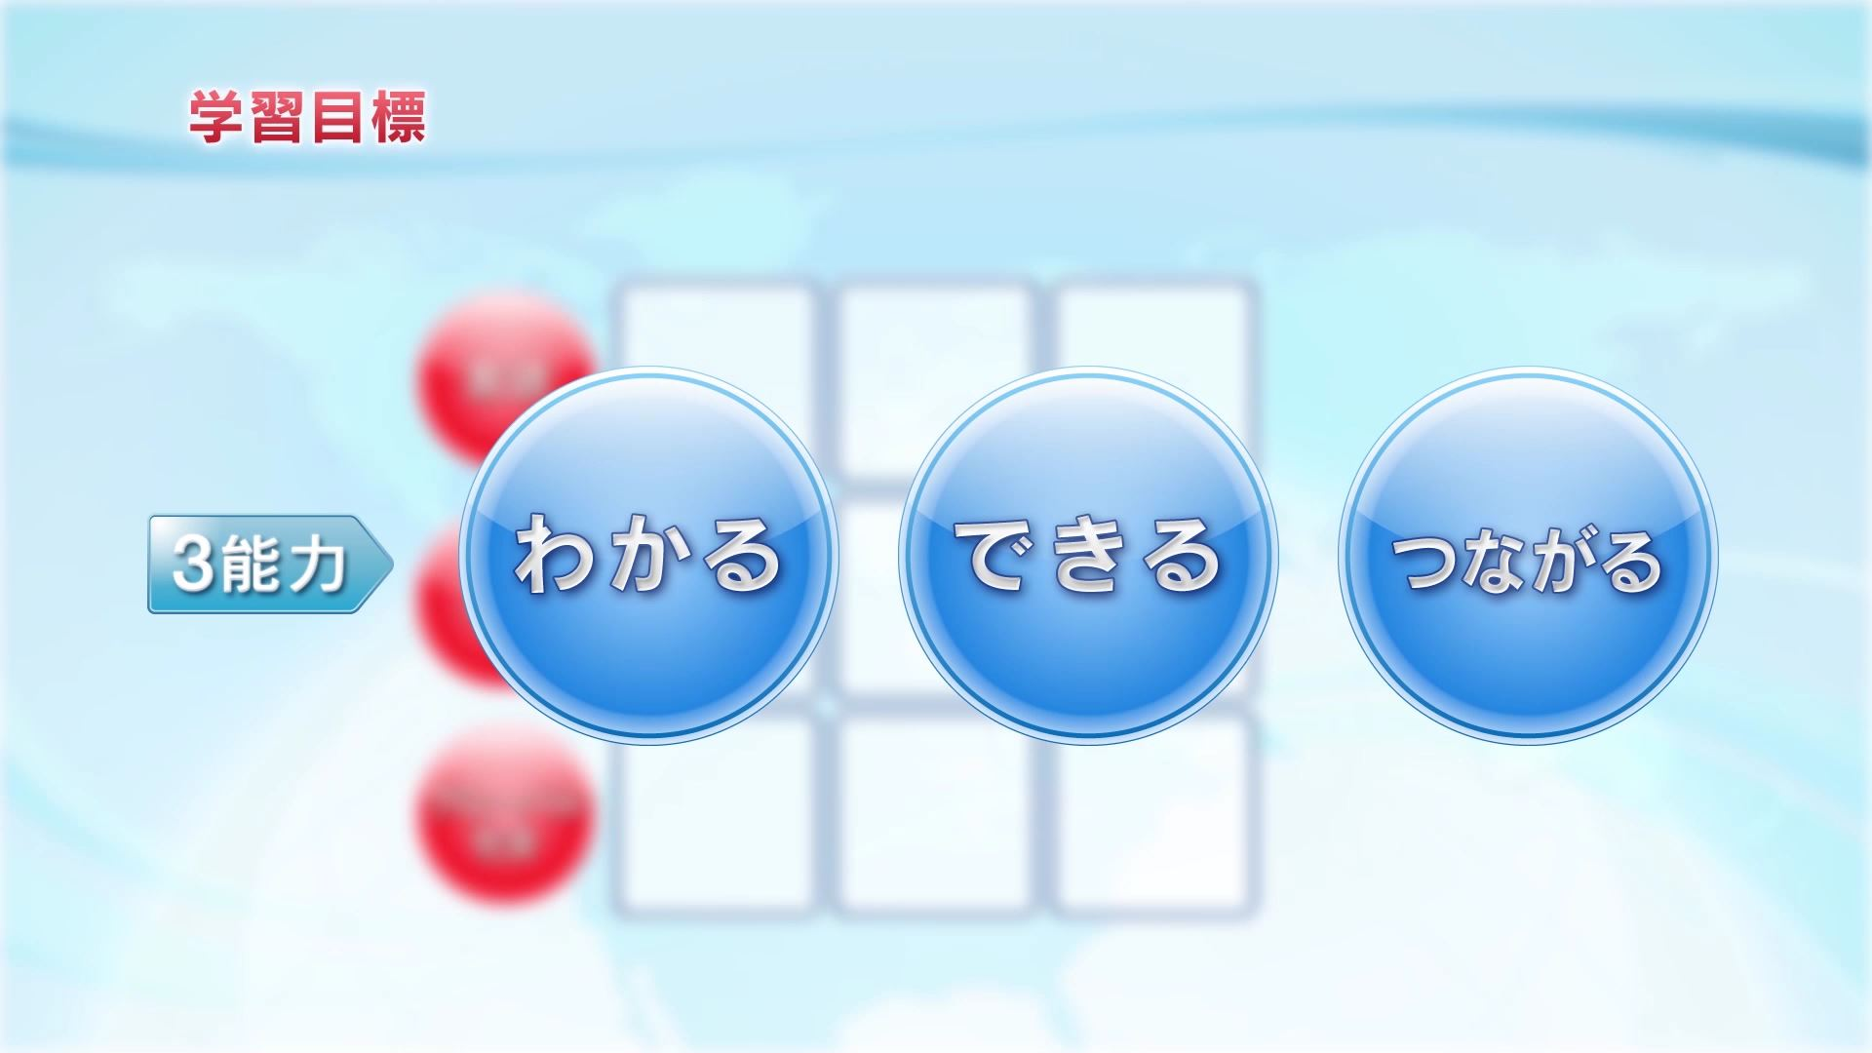
Meyasu named these the competencies of comprehension, implementation and connectedness.

Slide 16
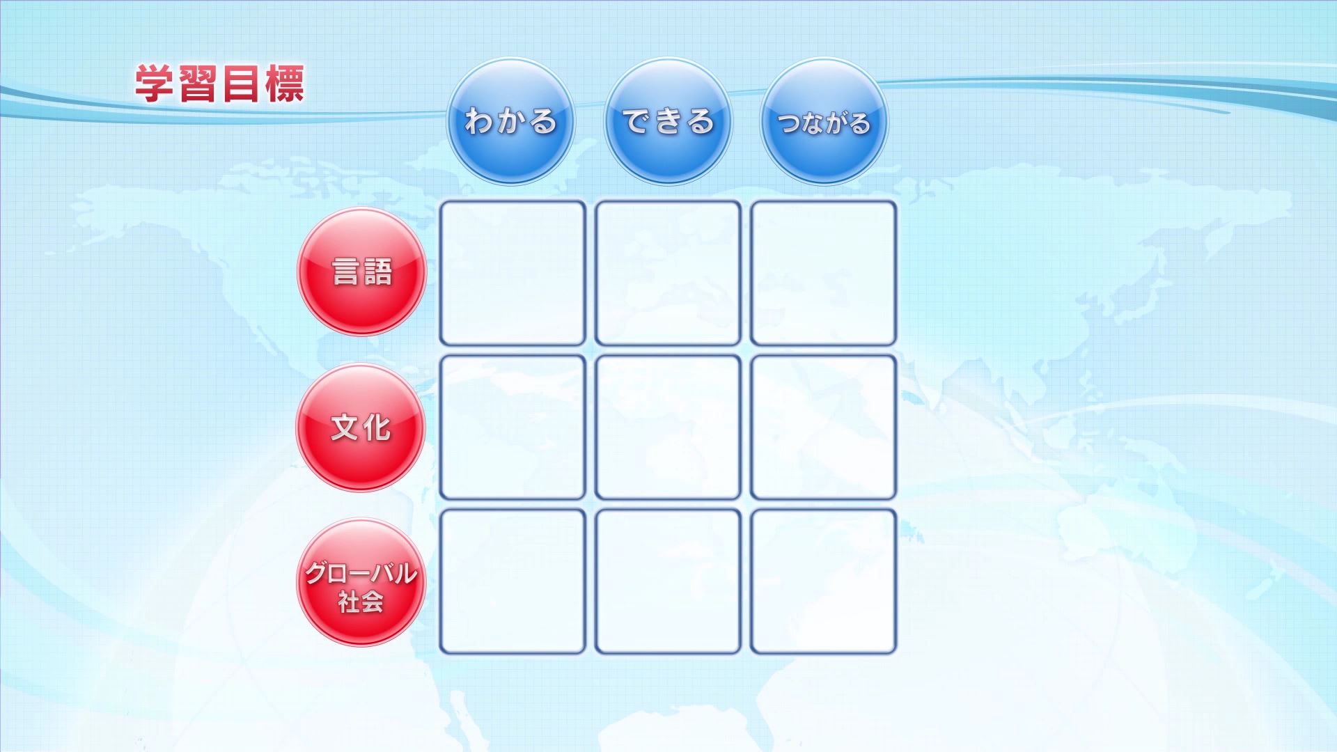

Slide 17
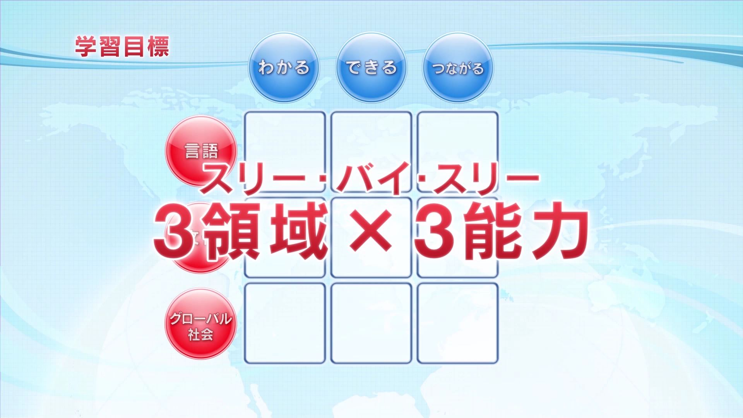
This table that broken down the learning target into 3 dimensions and 3 competencies is named "three by three," for short.

Slide 18
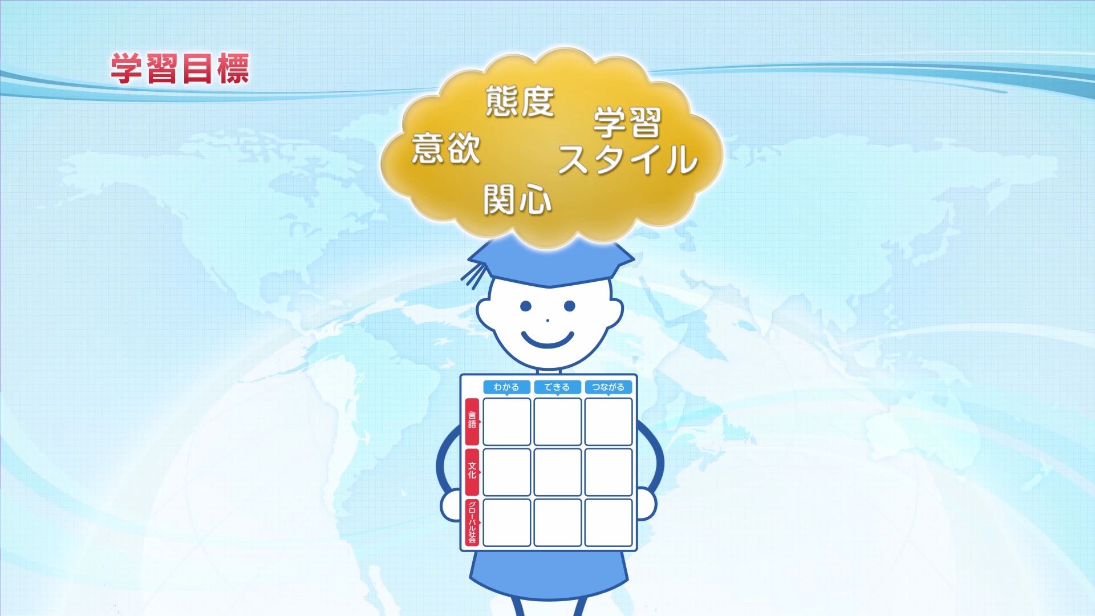
To achieve the targets shown in three by three, each learner's learning style such as interests, willingness to learn, and attitudes needs to be taken into account.

Slide 19
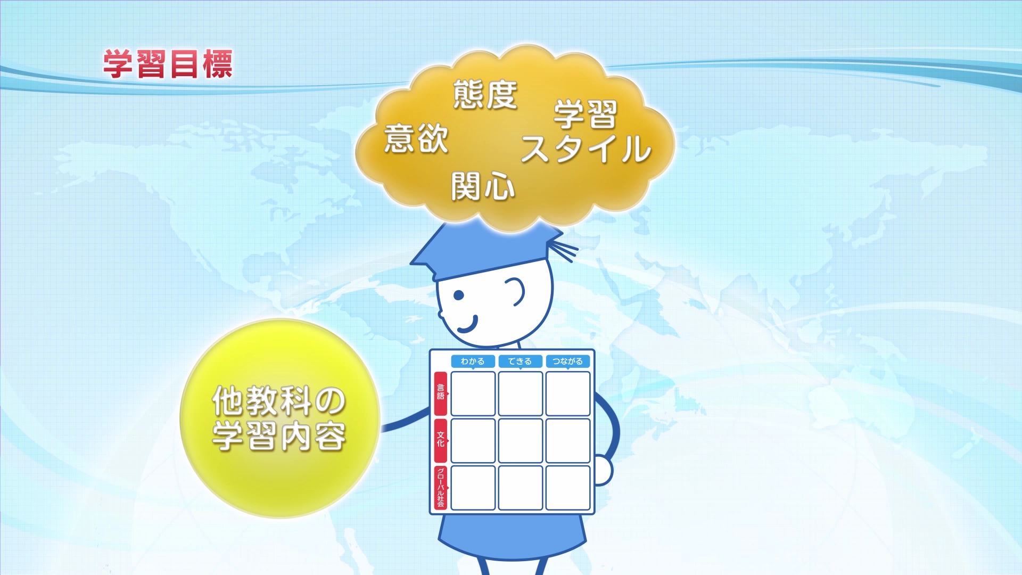
Besides, associating the study contents with that of other subjects helps enhance learning.

Slide 20
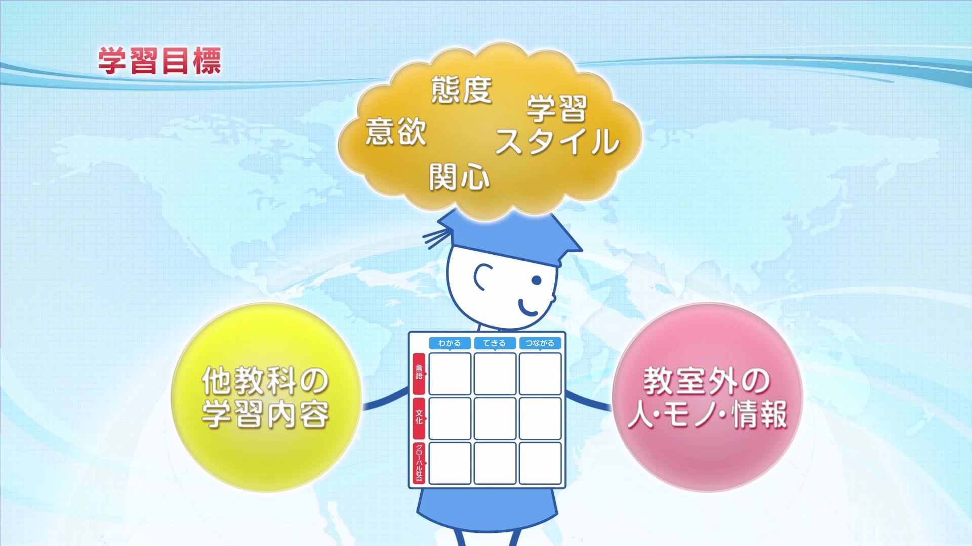
Furthermore, connecting the classroom with the real society is important to nurture competencies of implementation and connectedness.

Slide 21
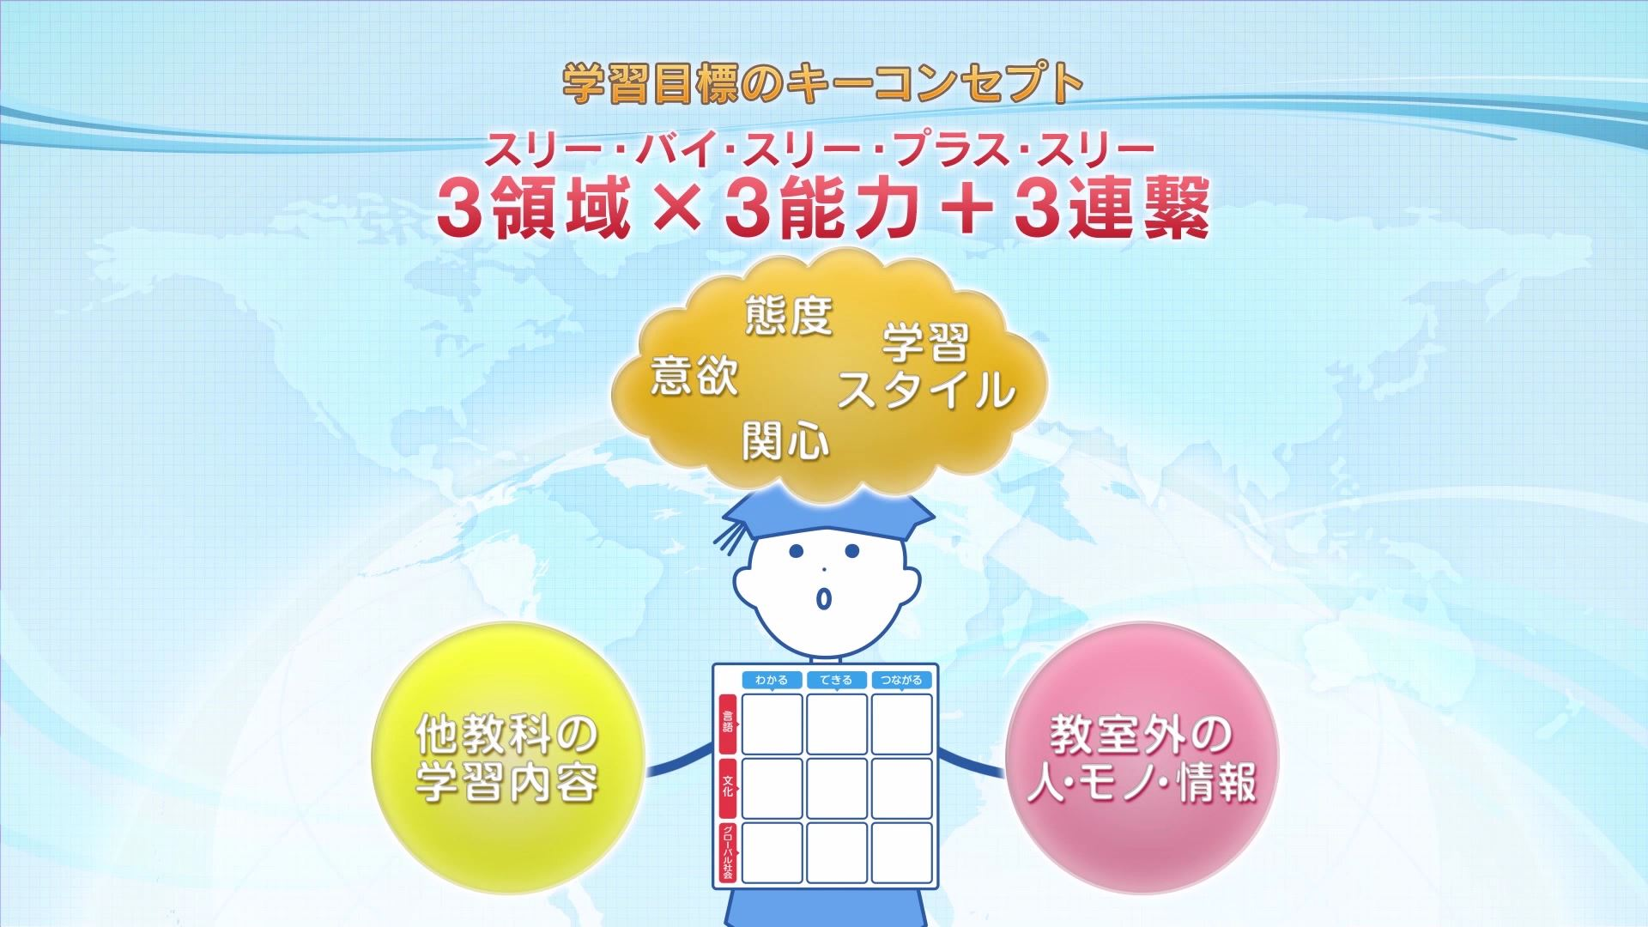
Reinforcing three dimensions by three abilities with three connections, Meyasu expresses its key concept of learning target as three by three plus three.

Slide 22
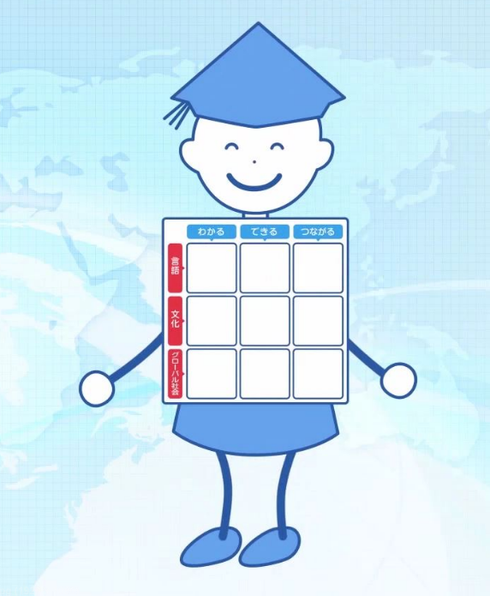
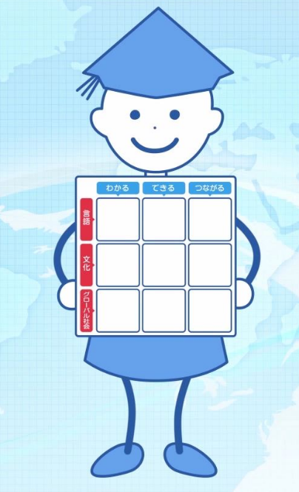
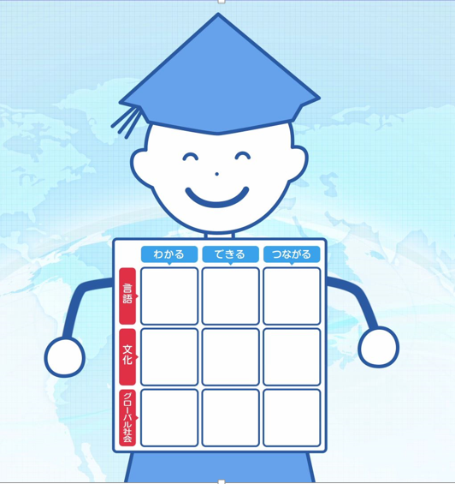
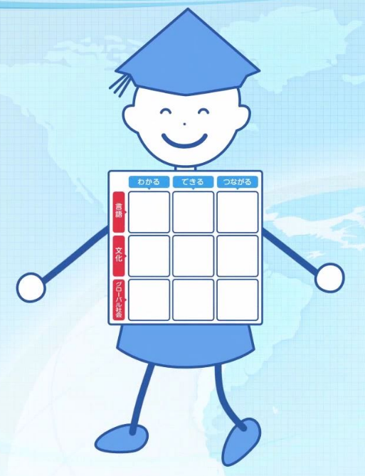
The comprehensive communication competence developed in line with three by thee plus three is designed to empower learners in their real life activities.

Slide 23
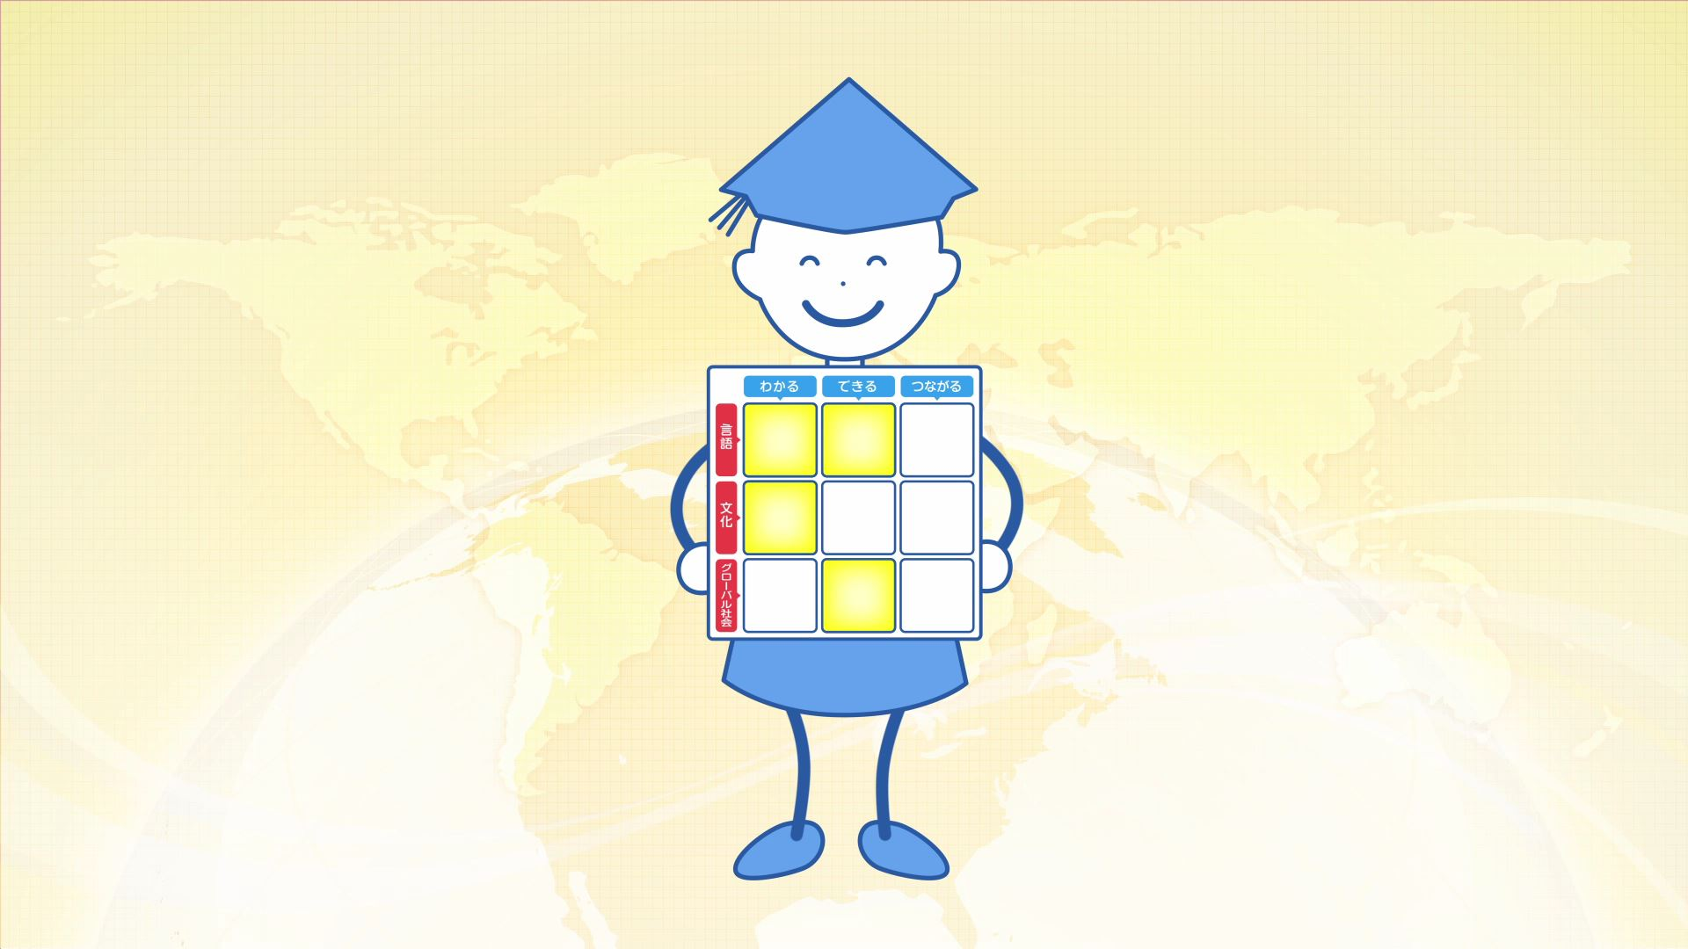
Learners can start with any of the three dimensions and three abilities.

Slide 24
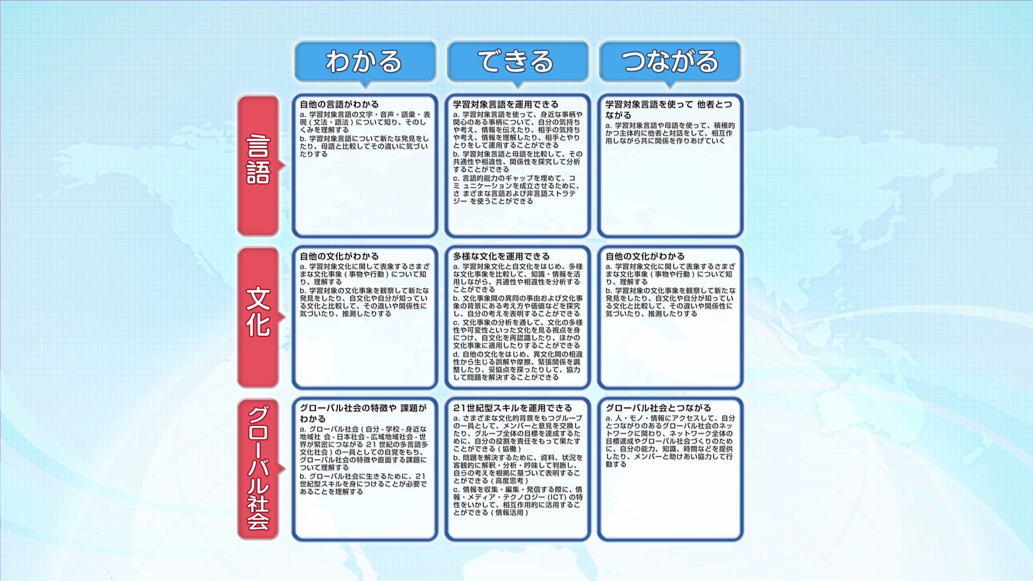
For each cells of the three by three table, different learning targets are set. It shows that interacting with overseas contemporaries and inking with the real world are equally important to acquiring language knowledge.

Slide 25
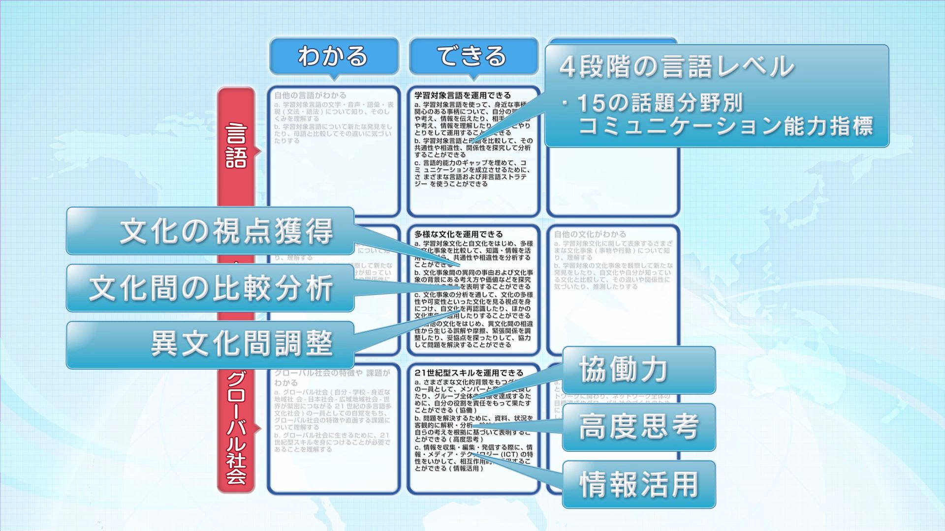
More detailed learning targets are set for implementation competencies in each three dimensions of language, culture and global society.

Slide 26
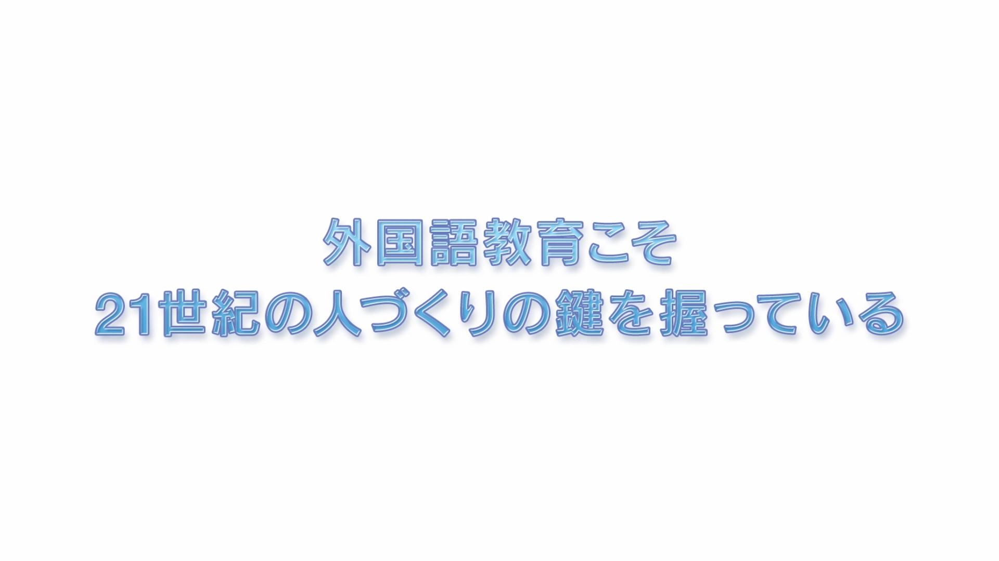
Let's support learners' growth step by step according to the thee by thee learning targets.

Slide 27
